Slide 1

PHYSICS FOR COMPUTING (CSPS 132) Topic Physical Quantities
Presented by:
Dr. Mark Ofori Nketia, Lecturer

Slide 2
Learning Objectives:
By the end of this section, you will be able to do the following:
Understand the role of measurements
Associate physical quantities with their International System of Units (SI)
Relate measurement uncertainty to significant figures
Understand the importance of numerical accuracy and significant digits
Differentiate base quantities and derivative quantities.
Apply the concept of quantities and units in physics.
Analyze the motion of objects that move horizontally while undergoing constant vertical acceleration.
Analyze the dimension of physical quantities.
Apply dimension to check the formula in physics

Slide 3
What is Physics?
Physics is the branch of science, that deals with the study of nature and the properties of matter and energy. Physics is a science of measurement. The things which are measured are called physical quantities which are defined by describing how they are to be measured.

Slide 4
Fundamental, Absolute or Base Quantities
Although the number of physical quantities that we measure is very large, we need only a limited number of units for expressing all the physical quantities since they are interrelated with one another. So, certain physical quantities have been chosen arbitrarily and their units are used for expressing all the physical quantities, such quantities are known as Fundamental, Absolute or Base Quantities (such as length, time and mass in mechanics) :

Slide 5
(i) All other quantities may be expressed in terms of fundamental quantities.
(ii) They are independent of each other and cannot be obtained from one another. An international body named General Conference on Weights and Measures chose seven physical quantities as fundamental;
(1) Length
(2) mass
(3) time
(4) electric current,
(5) thermodynamic temperature
(6) amount of substance
(7) luminous intensity.

Slide 6
Derived Quanties
Physical quantities which can be expressed as combination of base quantities are called as derived quantities. For example : Speed, velocity, acceleration, force, momentum, pressure, energy etc.

Slide 7
FUNDAMENTAL AND DERIVED UNITS
Unit: The known fixed physical quantity is called unit. OR The quantity used as a standard for measurement is called unit.
Measurement: In our daily life, we need to express and compare the magnitude of different quantities; this can be done only by measuring them. Measurement is the comparison of an unknown physical quantity with a known fixed physical quantity.

Slide 8
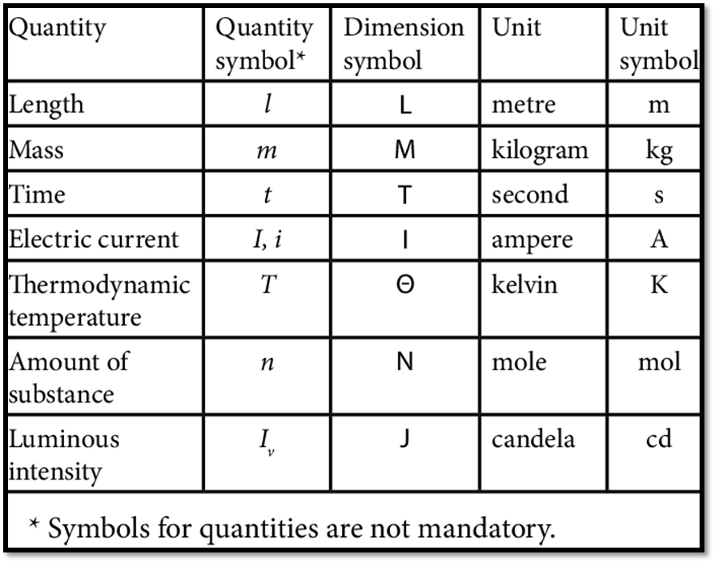
FUNDAMENTAL AND DERIVED UNITS

Slide 9
Definition of Basic and Supplementary Unit of S.I.
1. Metre (m): The metre is the length of the path travelled by light in vacuum during a time interval of 1/299 792 458 of a second.
2. Kilogram (Kg) : The kilogram is the mass of the platinum-iridium prototype which was approved by the Conference Generale des Poids et Mesures, held in Paris in 1889, and kept by the Bureau International des Poids et Mesures.
3. Second (s): The second is the duration of 9192631770 periods of the radiation corresponding to the transition between two hyperfine levels of the ground state of Cesium133 atom.
4. Ampere (A) : The ampere is the intensity of a constant current which, if maintained in two straight parallel conductors of infinite length, of negligible circular cross-section, and placed 1 metre apart in vacuum, would produce between these conductors a force equal to 2 x 10- 7Newton per metre of length.

Slide 10
5. Kelvin (K): Kelvin is the fraction 1/273.16 of the thermodynamic temperature of the triple point of water.
6. Candela (Cd): The candela is the luminous intensity, in a given direction, of a source that emits monochromatic radiation of frequency 540 x 1012 hertz and that has a radiant intensity in that direction of 1/683 watt per steradian.
7. Mole (mol): The mole is the amount of substance of a system which contains as many elementary entities as there are atoms in 0.012 kilogram of Carbon-12.

Slide 11
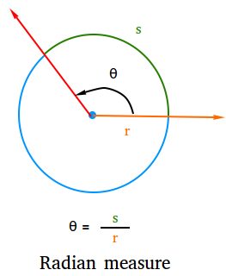
Supplementary units:
Radian (rad): It is supplementary unit of plane angle. It is the plane angle subtended at the centre of a circle by an arc of the circle equal to the radius of the circle. It is denoted by θ = l / r; l is length of the arc and r is radius of the circle

Slide 12
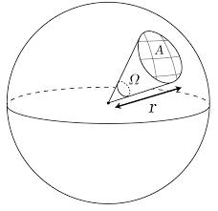
Steradian (Sr): It is supplementary unit of solid angle. It is the angle subtended at the centre of a sphere by a surface area of the sphere having magnitude equal to the square of the radius of the sphere. It is denoted by Ω.
Ω=A/r

Slide 13
Derived Units
There are two major systems of units used in the world: SI units (acronym for the French Le Systeme International d’Unites, also known as the metric system), and English units (also known as the imperial system).

Slide 14
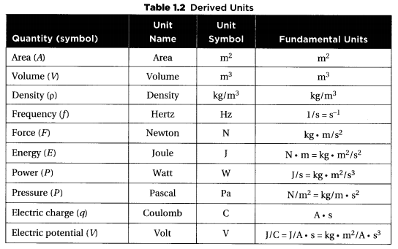

Slide 15
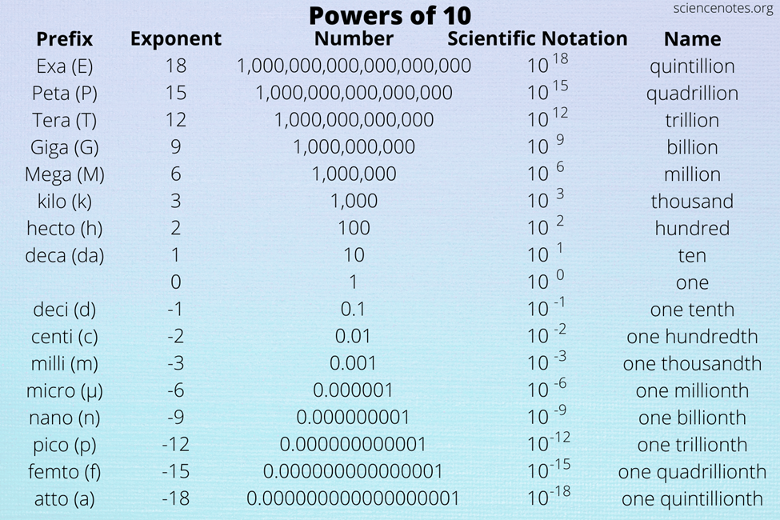
Prefixes (The power of 10)
For very large or very small numbers, we can use standard prefixes with the base units.
The main prefixes that you need to know are shown in the table.

Slide 16
Measurement of Time intervals
A clock is used to measure the time interval. An atomic standard of time, is based on the periodic vibration produced in a Cesium atom.
Some of the clocks developed later are electric oscillators, electronic oscillators, solar clock, quartz crystal clock, atomic clock, decay of elementary particles, radioactive dating etc.
The order of time intervals are tabulated at the next page.

Slide 17
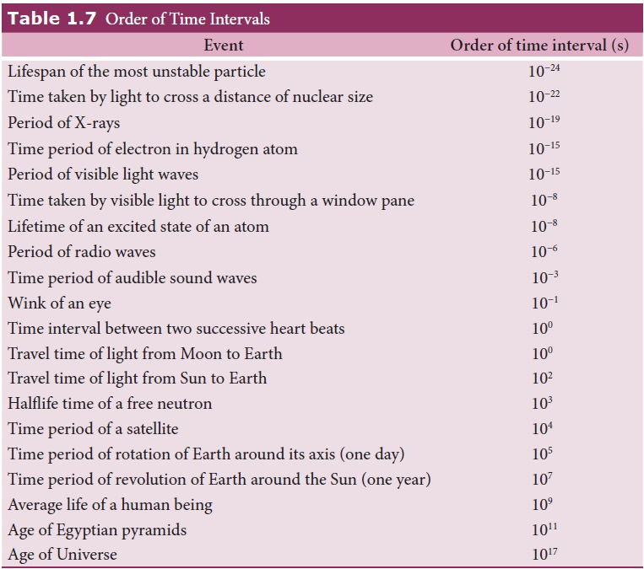
Order of Time Interval

Slide 18
Scalar and Vector Quantities
Scalar quantities
Remember scalar quantities only have a magnitude (size)
Distance: the total length between two points
Speed: the total distance travelled per unit of time
Vector quantities
Remember vector quantities have both magnitude and direction
Displacement: the distance of an object from a fixed point in a specified direction
Velocity: the rate of change of displacement of an object
Acceleration: the rate of change of velocity of an object

Slide 19
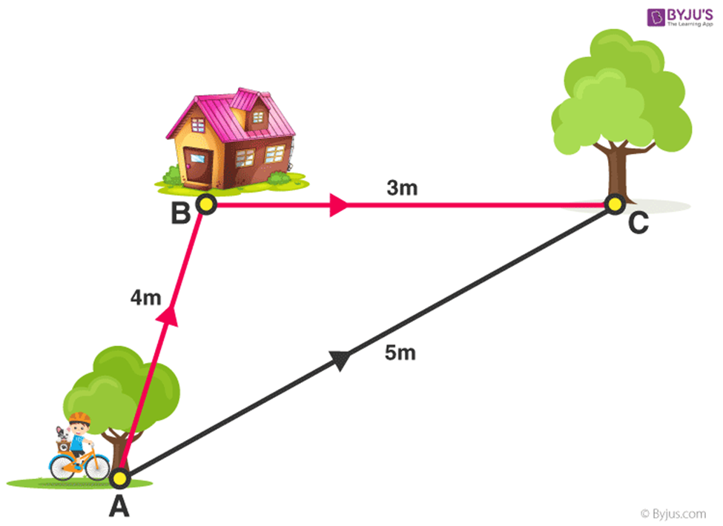
Displacement and Distance

Slide 20
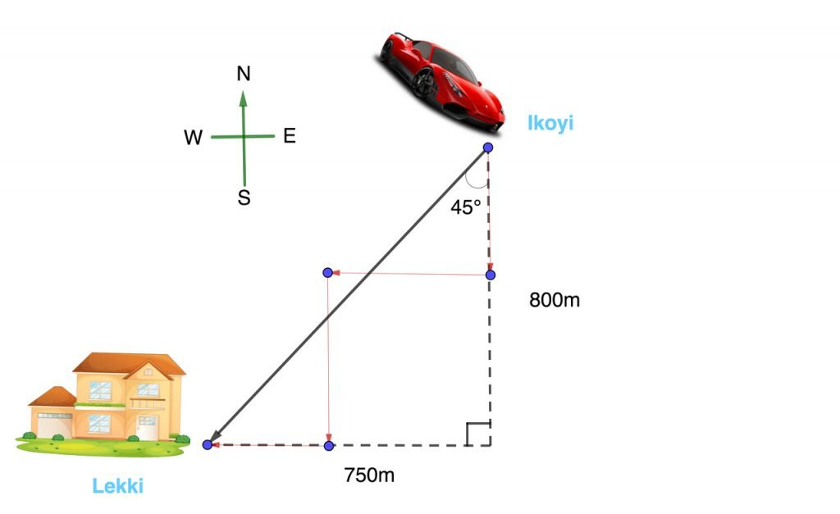

Slide 21
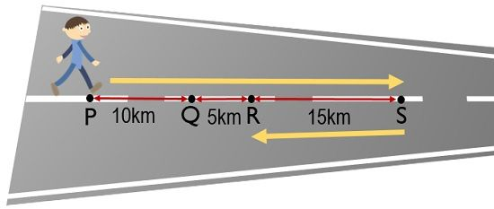
Distance covered is 10km+5km+15km =30Km Displacement is 10km +5Km = 15Km

Slide 22
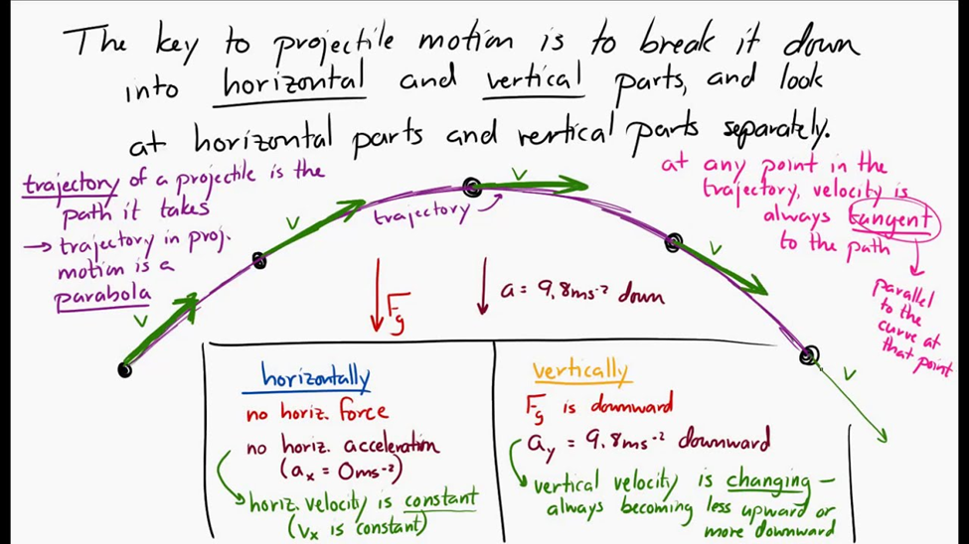
Projectile; Displacement, Velocity, Acceleration

Slide 23
Dimensional Anaysis
The study of the relationship between physical quantities with the help of dimensions and units of measurement is termed dimensional analysis. Dimensional analysis is essential because it keeps the units the same, helping us perform mathematical calculations smoothly. On the basis of dimension, we can classify quantities into four categories.
1. Dimensional variables
Physical quantities, which possess dimensions and have variable values are called dimensional variables. Examples are length, velocity, and acceleration etc.
2. Dimensionless variables
Physical quantities which have no dimensions, but have variable values are called dimensionless variables. Examples are specific gravity, strain, refractive index etc.

Slide 24
3. Dimensional Constant
Physical quantities which possess dimensions and have constant values are called dimensional constants. Examples are Gravitational constant, Planck’s constant etc.
4. Dimensionless Constant
Quantities which have constant values and also have no dimensions are called dimensionless constants. Examples are π, e, numbers etc.

Slide 25
Applications of Dimensional Analysis
Dimensional analysis is a fundamental aspect of measurement and is applied in real-life physics. We make use of dimensional analysis for three prominent reasons:
To check the consistency of a dimensional equation
To derive the relation between physical quantities in physical phenomena
To change units from one system to another

Slide 26
Limitations of Dimensional Analysis
Some limitations of dimensional analysis are:
It doesn’t give information about the dimensional constant.
The formula containing trigonometric function, exponential functions, logarithmic function, etc. cannot be derived.
It gives no information about whether a physical quantity is a scalar or vector.

Slide 27
Uses of dimensional equation:
The principle of homogeneity & dimensional analysis has put to the following uses: (i) Checking the correctness of physical equation.
(ii) To convert a physical quantity from one system of units into another.
(iii) To derive relation among various physical quantities

Slide 28
Principle of homogeneity of dimensions
The principle of homogeneity of dimensions states that the dimensions of all the terms in a physical expression should be the same.
For example it’s not logical to say that: 2 Mangoes + 3 laptops = 5 Helicopters
There are three fundamental quantities in mechanics
Mass - M
Length - L
Time – T

Slide 29
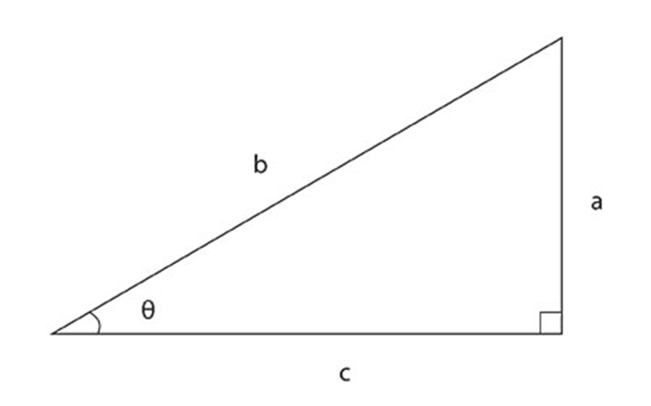
Dimensionless Quantities
Some quantities have no dimensions. For example, the sine of an angle is defined as the ratio of the lengths of two particular sides of a triangle.
Sinθ=a/b
so,
Sinθ has dimensions of L/L=1
∴Sinθ is dimensionless
Thus, the dimensions of the sine are L/L, or 1. Therefore, the sine function is said to be "dimensionless".

Slide 30
Dimensionless Quantities
all trigonometric functions
exponential functions
logarithms
angles (but notice the discussion in the next paragraph)
quantities which are simply counted, such as the number of people in the room
plain old numbers (like 2, ππ, etc.)

Slide 31
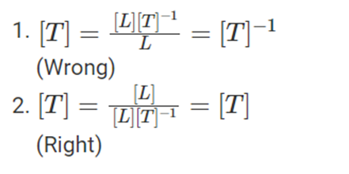
Using Dimensional Analysis to Check the Correctness of Physical Equation
Let’s say that you don’t remember whether
time = speed/distance, or
time = distance/speed
We can check this by making sure the dimensions on each side of the equations match.
Reducing both the equations to its fundamental units on each side of the equation, we get

Slide 32
Using Dimensional Analysis to Check the Correctness of Physical Equation
Example: Is v = at dimensionally correct?
Solution:
Here, LHS: velocity, v
v = [LT⁻¹]
And, RHS = at i.e. acceleration × time
Acceleration = [LT⁻²]
Time = [T]
Therefore, at = [LT⁻¹]
Hence,
LHS = RHS
and the given equation is dimensionally correct.

Slide 33
Example 2:
For example, in the physical expression v² = u² + 2as, v² = u² + 2as is the third equation of motion. We already remember that distance equals average velocity multiplied by time. 2as = v² – u² or v² = u² + 2as. The link between the particle's final velocity v, starting or initial velocity u, constant speed a, with displacement S is the 3rd equation of motion.
So lets consider the physical quantities s, v, a, and t with dimensions [s] = L, [v] = LT−1, [a] = LT−2, and [t] = T. Determine whether each of the following equations is dimensionally consistent:
a. s = vt + 0.5at2;
b. v² = u² + 2as

Slide 34
Strategy
By the definition of dimensional consistency, we need to check that each term in a given equation has the same dimensions as the other terms in that equation and that the arguments of any standard mathematical functions are dimensionless.

Slide 35
Solution (a):
There are no trigonometric, logarithmic, or exponential functions to worry about in this equation, so we need only look at the dimensions of each term appearing in the equation. There are three terms, one in the left expression and two in the expression on the right, so we look at each in turn:
We know that L.H.S = s and R.H.S = ut + 1/2at²
The dimensional formula for the L.H.S can be written as
s = [L¹M⁰T⁰] ………..(1)
We know that R.H.S is ut + ½ at² , simplifying we can write R.H.S as [u][t] + [a] [t]²
We know that V=L/T and a=ΔV/T =L/T²

Slide 36
So now, R.H.S = [u][t] + [a] [t]²
=[L¹M⁰T⁻¹][L⁰M⁰T¹] +[L¹M⁰T⁻²][L⁰M⁰T¹]²
=[L¹ M⁰T⁰] +[L¹ M⁰T⁻²] [L⁰M⁰T²]
=[L¹ M⁰T⁰] +[L¹ M⁰T⁰]
=[L¹M⁰T⁰]………..(2)
From (1) and (2), we have [L.H.S] = [R.H.S]
Hence, by the principle of homogeneity, the given equation is dimensionally correct.

Slide 37
Solution b:
The computations made on the L.H.S and R.H.S are as follows:
L.H.S: v² = [v²] = [ L¹M⁰T^{–1}]² = [ L²M⁰T^{–2}] ……………(1)
R.H.S: u² + 2as²
Hence, [R.H.S] = [u]² + 2[a][s]²
[R.H.S] = [L¹M⁰T^{–1}]² + [L¹M⁰T^{–2}][L¹M⁰T⁰]²
[R.H.S] = [L²M⁰T^{–2}] + [L¹M⁰T^{–2}][L²M⁰T⁰]
[R.H.S] = [L²M⁰T^{–2}] + [L³M⁰T^{–2}]…………………(2)
From (1) and (2), we have [L.H.S] ≠ [R.H.S]
Hence, by the principle of homogeneity, the equation is not dimensionally correct.

Slide 38
Key Notes:
Base quantities are the quantities on the basis of which other quantities are expressed.
The quantities that are expressed in terms of base quantities are called derived quantities
Dimensions are Absolutes therefore should be in brackets
Scalar quantities have magnitudes
Vector quantities have magnitude and direction
……

Slide 39
References:
David Halliday, Robert Resnick, Jearl Walker (2012), Fundamentals of Physics, Willey publishers
LibreText (2022) Physics: Dimensional Analysis, https://phys.libretexts.org/Bookshelves/University_Physics
Igor S. Grigoriev, ‎Evgenij Zalmanovič Mejlichov, ‎Evgenii Z. Meilikhov · (1997) Handbook of Physical Quantities, CRC-Press, ISBN 0849328616, 9780849328619

Slide 40
Thank you

